Slide 1
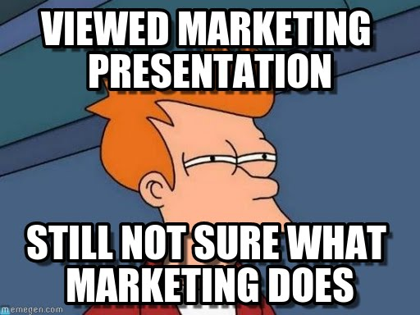

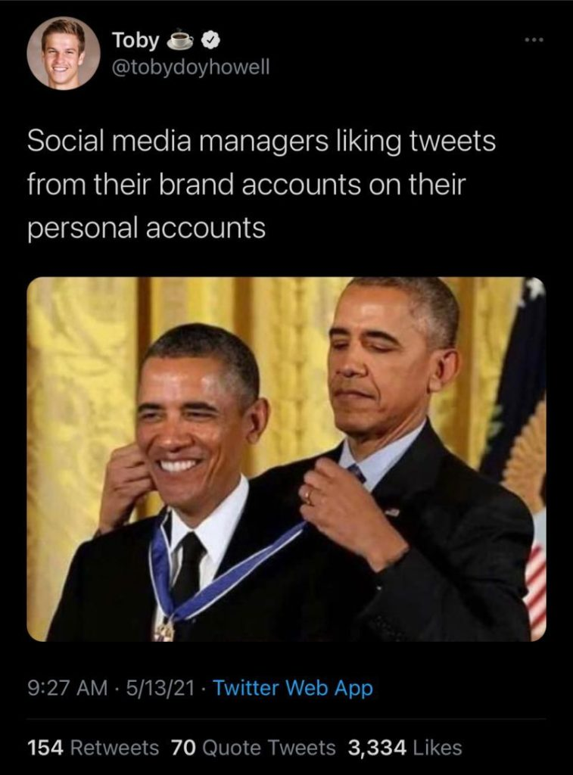
Am I in the right class?

Slide 2




Introduction to Marketing Research
Notes:
Hi This is the Marketing Research 4050 Course.
Make sure that you are in the right class
Pass along cardboard paper so students can write their names

Slide 3
Agenda
Introduction
Install iClicker reef- name, Mizzou email
Discussion 1: Intro about yourself (on Canvas):
A fun fact about you
Structure of the class
Syllabus
Attendance & class participation on iClicker
Case Discussion
Term Project
Weekly Quiz
Name
Hometown
Notes:
Please post your introduction on Canvas so your classmates and I can get to know you. And it can also serve as a basis form groups later on.
These questions have been inspired by professor Alyssa Carlson
https://www.youtube.com/watch?v=0D7hFHfLEyk
What is your name? State your name and where you are from
What is your quest? What year are you (e.g., junior, senior)? What would you like to do at the end of your program (e.g., sales agent, marketing consultant, etc.)?
What is your favorite color? Tell an interesting fact, hobby, or experience you have.
What is the airspeed velocity of an unladen swallow? Some questions are just hard! What question would you like to be able to answer at the end of this course? In other words, what would you like to learn about marketing research?

Slide 4

Instructor Bio
Name: Mike Nguyen
Office: Room 417
Office Hour: 11:00 AM – 11:30 AM (Monday) or by appointment
Email: mikenguyen@mail.missouri.edu
Mizzou bio
Personal Website: https://mikenguyen.netlify.app/
Notes:
My name is Mike Nguyen. I am extremely happy that y’all are here today. I am really excited to accompany you throughout this semester in this Marketing Research class.
You can call me Mike, professor Mike, or professor Nguyen. I’ll answer pretty much everything.
My background is in economics, finance, marketing, and statistics.
You can find out more info about me on my Mizzou page or on my personal website
My office is 417
And my office hour is
You can also reach me via email at

Slide 5
Syllabus
Access to materials
Canvas: publish a week before
All tests and quizzes are on Canvas
Syllabus
Notes:
On Canvas, all the materials will be posted a week before so you can have time to prepare it early if you wish
There might some be typos or broken Links. Please let me know if you can’t access the materials.
And you can just interrupt me if you have a question.
Now, we can go over the syllabus together.
All tests and quizzes will be on Canvas.

Slide 6
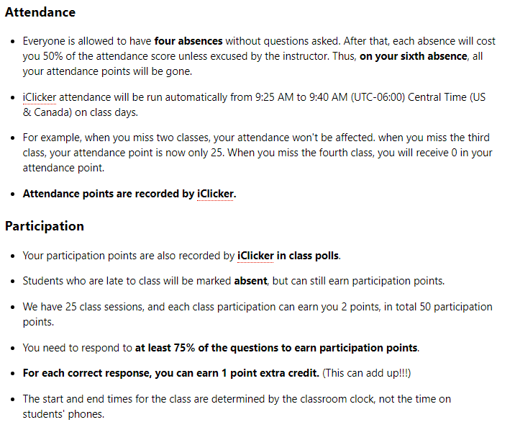
Attendance, Participation points, and Professionalism
Notes:
This is straight from the syllabus, so if you guys can pull up on your computer, your phone or print it out, it would be easier to follow along.
It would come in handy later when you want to refer back to these policies.
Every day, you will receive attendance points just by being in class and answer questions.
But to receive participation points, you have to answer at least 75% of the questions posted in class, which usually consists of
1 to 2 questions that recap materials from the last class.

Slide 7

IClicker Reef
Make sure you are registered by the end of this class
First class, I do not take any attendance or participation points
Notes:
I see that most of you already have iclicker account, just make sure you are in the class.
And I will run participation questions to let you familiarize yourself with iclicker
If you can’t figure out how to register your iclicker, please talk to me after class

Slide 8
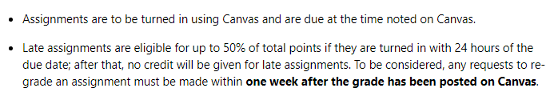
Assignments

Slide 9
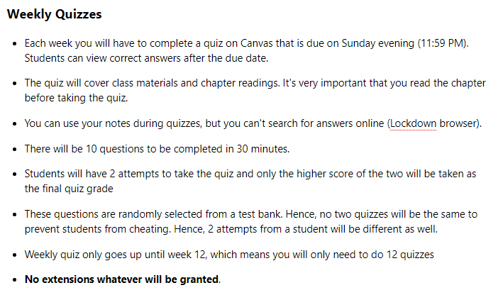
Weekly Quizzes
Notes:
Please remember to read up on the chapter materials. I don’t want to waste your time by just repeating everything from the book in class because I can safely assume that you guys read the chapter, and go to class for more information and new materials.
Quizzes are based on both in-class and chapter materials.
Remember, quizzes require you to have lockdown browser.
And please do the practice quiz before doing a real one (go to practice quiz)
More specifically, (go into the slide)

Slide 10


Lockdown Browser
Notes:
https://etopics.missouri.edu/support/solutions/articles/1000185802-respondus-lockdown-browser-at-mizzou
Lockdown browser is a browser. Hence, please do not use Chrome or any other browser, you have to access your quiz via Lockdown browser in order to take the quizzes and exams.

Slide 11

Lockdown Browser
Open Lockdown Browser
Log in Canvas
Proceed to take quizzes or exams
Computer Lab
Lockdown Browser 2 Lab
This Photo by Unknown Author is licensed under CC BY
Notes:
It’s a browser, so don’t use Google Chrome, Safari, or Firefox.
In case you don’t have Lockdown browser on your computer, or if your computer acts up, the computer lab on the basement also has Lockdown Browser, but it’s called Lockdown Browser 2 Lab.
You can just go there and take your quizzes and exams when there isn’t research being conducted.
This is why I strongly recommend you to take the quiz early in case you have problem.
Sometimes, I can’t answer your email right away, so keep that in mind.

Slide 12
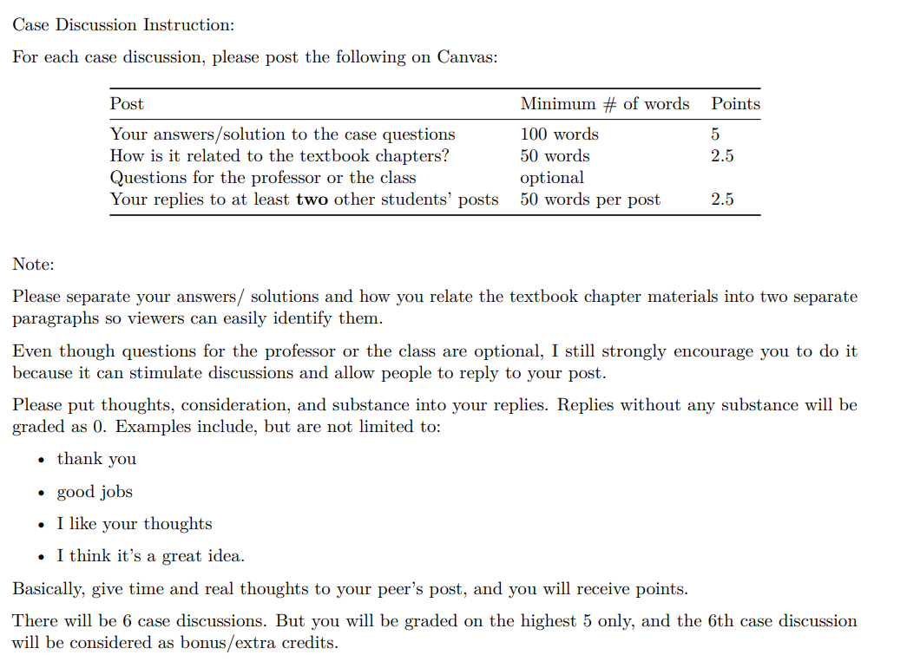
Case Dicussion
Notes:
Each post consists of 4 parts:

Slide 13
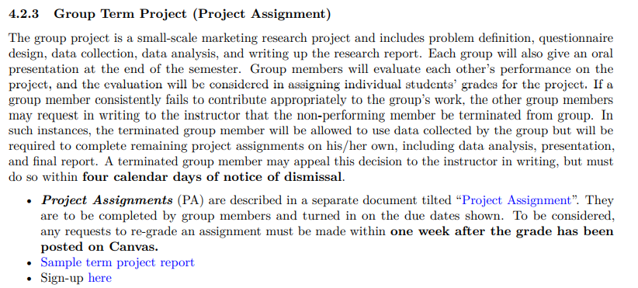
Group Term Project
Notes:
This is a small-scale group project that you have a chance to work on from the beginning till the end of a marketing research project. There will be 13 assignments in total
To access the project assignments document, you can simply click on the URL in your syllabus.
(Now go to the project assignments)
Let students mingle (5 mins).
Since we have 32 students, a group can have up to 5 or 6 people.

Slide 14
Exams
2 Exams
Multiple choice questions
Same format as quizzes

Slide 15
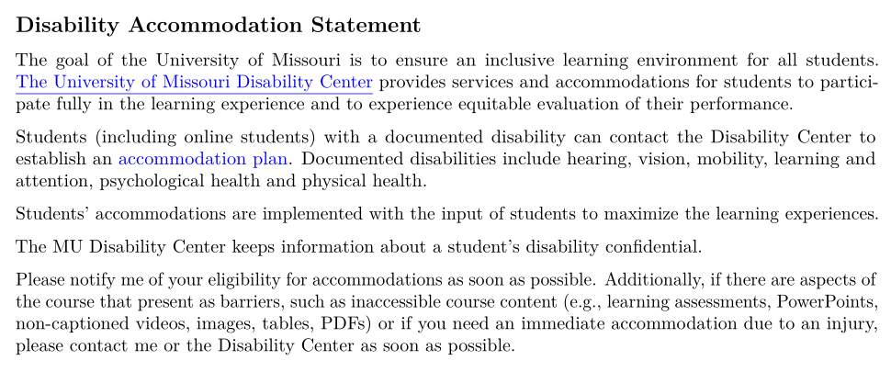
Covid
Disability Center
Notes:
If your want to request remote access because they are immunocompromised or for other disability reasons associated with the COVID-19 pandemic, please refer to the Disability Center.
For your confidentiality, and to make sure your full needs are met, you need to first establish accommodations with the Disability Center. They will guide you through the process and inform me of what accommodations you should receive in my class

Slide 16
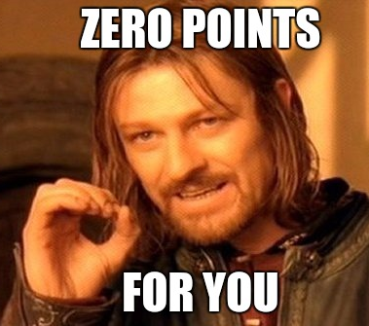
Policy on Discrimination
Notes:
Here at Mizzou, we do not tolerate discrimination

Slide 17
5-min Snippet
Text Analysis/ Mining:
Wordcloud
Sentiment Analysis
Agent-based Modeling
Network Analysis
Notes:
This section is the most exciting part for me in this class.
I call this the 5-min snippet, which means that at the end of every class, about 5 minutes, I will show you some of the most interesting (at least in my opinion) and state-of-the-art research methods in marketing and various social science disciplines. Since I cannot teach you these materials formally and I have to adhere strictly to the marketing research textbook, this is my way to rebel. However, I understand why our program requires you guys to learn the basic (bread and butter) of marketing research. But since this is the only marketing research you’re required to take before graduation, I don’t think you have a chance to learn more methods. Hence, I hope at least I can introduce that there are more out there that you can learn to be more competitive on the job market.
Mostly, we will cover text mining, agent-based modeling, and network analysis in this section.
Later you will have a taste of what this section is all about

Slide 18
Outline of content
Define Marketing Research
Purpose of Marketing Research
Marketing Research Problems
Examples of Marketing Research
Marketing Research Process
Notes:
We will cover the first chapter
Marketing definition, its purpose, its process and a few examples of marketing research

Slide 19

What is marketing research in your own term?
This Photo by Unknown Author is licensed under CC BY-SA-NC
Notes:
What first come to your mind when I say marketing research?
Ask students

Slide 20
Define Marketing Research
Marketing research is the process of gathering and interpreting data for use in developing, implementing, and monitoring the firm’s marketing plans (Brown et al., 2018)
Notes:
Brown, T. J., Suter, T. A., & Gilbert, C. A. (2018). Basic marketing research : customer insights and managerial action (9th ed.). MA Cengage Learning. https://www.worldcat.org/title/basic-marketing-research-customer-insights-and-managerial-action/oclc/1004747547
This is the textbook definition that you’ve read.

Slide 21

Marketing Research
The process of designing, gathering, analyzing, and reporting information that may be used to solve a specific marketing problem
Notes:
Another definition that I like better is:
Design: specific questions to be answered

Slide 22
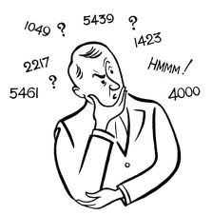



Marketing Research Process
Designing
Gathering
Reporting
Analyzing
Notes:
The above definition is tied strictly to the marketing research process, which typically consists of the following phases:
Designing: Specifying what information is needed
Gathering; Gathering the relevant data from internal and external sources
Analyzing: Analyzing and interpreting the data
Reporting: Communicating the results to the appropriate audiences

Slide 23

Purpose of Marketing Research
To link the consumer to the marketer by providing information that can be used in making marketing decisions
Notes:
The purpose of marketing research is to link…
So now you have the definition, process, and purpose of marketing research, can you identify a marketing research question?
The goal of marketing research is to create exchanges with customers that satisfy the needs of both the customer and the marketer

Slide 24
Is This Marketing Research?
Determine optimal promotional mix
Establish market potential for a new product
Determine product pricing
Determine location of retail outlets
Notes:
So these are examples of marketing research
What percentage of our target market remembers our brand name?
Should we advertise more in local print or broadcast media?
Which of two advertising campaigns produces greater ad recall?
Do consumers think our price is too high relative too the competition?
Are there more efficient channels of distribution for our products? Which brand name projects the image we want for our product?
What kinds of firms use our services?
What is the most effective trade promotion program?
What is our reputation with government regulatory agencies?
What is our reputation with government regulatory agencies?
Iclicker question

Slide 25
iClicker question
Which of the following questions can be addressed by utilizing marketing research?
What percentage of our target market remembers our brand name?
What kinds of financial firms use our services?
What is our reputation with government regulatory agencies?
All of the above

Slide 26




Marketing Research Firms
I am thinking about going to college. Which college should I target?
I want to take my friends out for dinner. I wonder what my options are
We want to watch a new flick and I don’t even like its promo, hmm.. Where can I get more information about it?
I am going to SFO, which sites should I visit?
Notes:
These are marketing research firms that help you bypass the hurdle of the marketing research process. And they make money by saving you time.
I will say my target or goal as a consumer, and you can tell me which agency first comes to your mind
By third party agency for the consumers

Slide 27

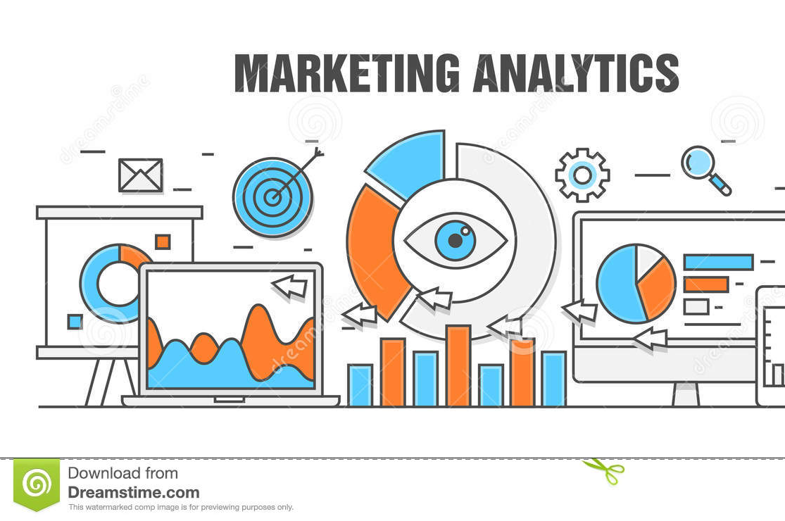

Terminology
Marketing Research vs. Marketing Analytics
Data Analyst vs. Data Scientist
Notes:
Does anyone know the difference between marketing research and marketing analytics?
Or the difference between data analysts and data scientists.
I think this can be helpful for you when you are interviewed and especially when you’re interviewed for tech companies, as I saw many of you’ve indicated in your introduction posts.

Slide 28
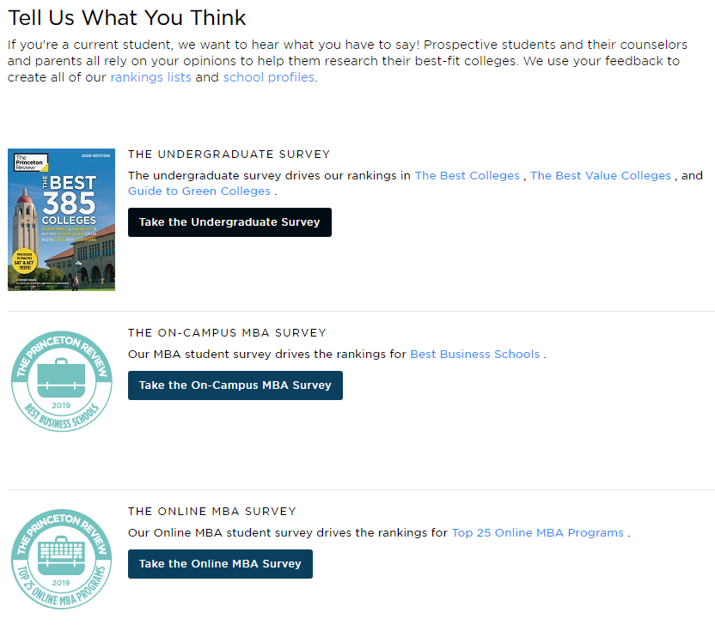
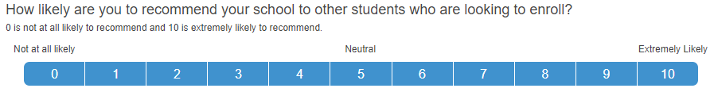
U.S. News Example

Slide 29

Recap & Next
Syllabus (attendance, PA, CE)
Purpose and definition of marketing research
Assignment due: PA #1
Read Chapter 1 (Quiz 1 – Sunday)

Slide 30

5-min Snippet
Spread of Disease
Notes:
http://www.netlogoweb.org/launch#http://www.netlogoweb.org/assets/modelslib/IABM%20Textbook/chapter%206/Spread%20of%20Disease.nlogo
This model explores the spread of disease in a number of different conditions and environments. In particular, it explores how making assumptions about the interactions of agents can drastically affect the results of the model.
Other models
HIV
Disease Solo
Disease HubNet
Disease Doctors HubNet
epiDEM Basic
epiDEM Travel and Control
Virus on a Network
Communication models:
Communication T-T Example
Communication-T-T Network Example
Language Change
In particular, look at how the different parameters of the model influence the speed at which the disease spreads through the population.
For example, in the “mobile” variant, the population (NUM-PEOPLE) clearly seem to be the main driving force for the speed of infection.
Try 50, 200, 400
Is that the case for the other two variants as well? Some suggestions of parameters to vary are given below under THINGS TO TRY.
Another thing that you may have noticed is that, in the “network” variant, there are cases where the disease will not spread to all people. , here we can see it plateaus .
This happens when the network has more than one components (isolated nodes, or groups of nodes that are not connected with the rest of the network)
and that not all components get infected with the disease right from the start
Similarly, set different values for the CONNECTIONS-PER-NODE slider and run the NETWORK variant. How does the CONNECTIONS-PER-NODE slider affect the results?
Set 1,2, 3 connections.
Now, we can try environnemental variant.
Set different values for the DISEASE-DECAY slider and run the ENVIRONMENTAL variant. How does the DISEASE-DECAY slider affect the results?
Set 3, 5, 8

